Slide 1




BeneFIX – Haemophilia
Monthly European IMS
July 2012
Alessandra Patella
Haemophilia ESAT Team

Slide 2















Click on symbol to jump to
Specific section and
Back to Summary
Summary
Market Coverage
  IMS Channel Coverage
Haemophilia Franchise Performance
  Value Performance Overview
BeneFIX Market Performance
  BeneFIX Market MAT Sales Performance per Country
  BeneFIX Market MAT Trends
BeneFIX Performance
  BeneFIX MAT Sales Performance
  BeneFIX Trends and Shares
  BeneFIX Historic Sales per Region
Country Performances
  Benefix Market Sales in individual Countries

Slide 3
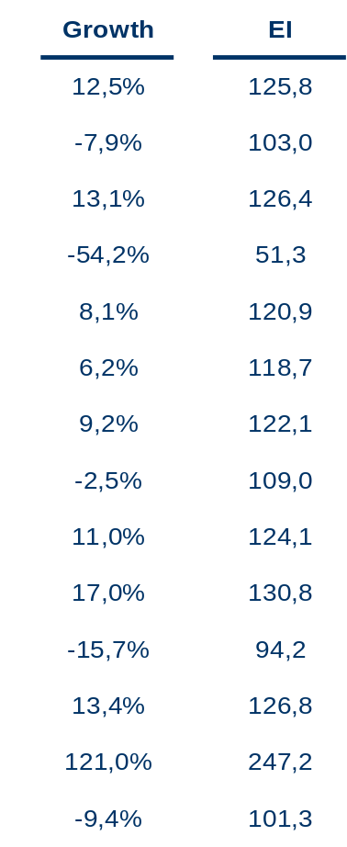
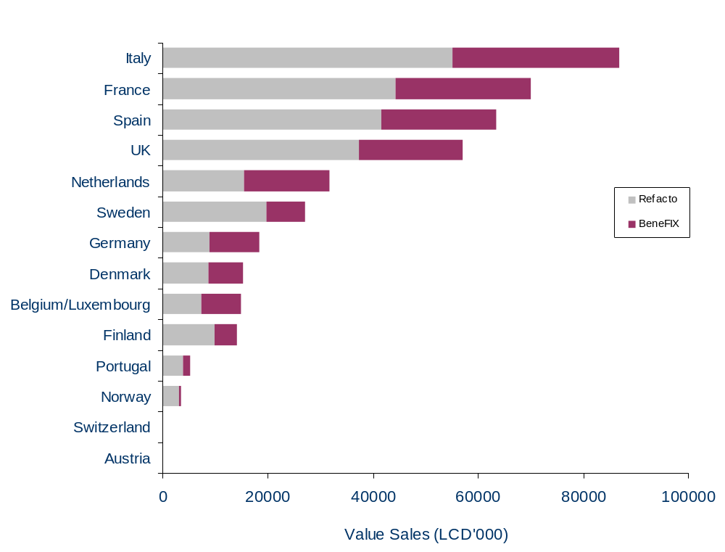
Haemophilia Franchise MAT Value Sales Performance
per Country
EI is calculated vs. the Europe 16 Haemophilia Market, Growth and EI are for total Haemophilia Franchise
Source: IMS MIDAS Data, MAT 07/2012

Slide 4
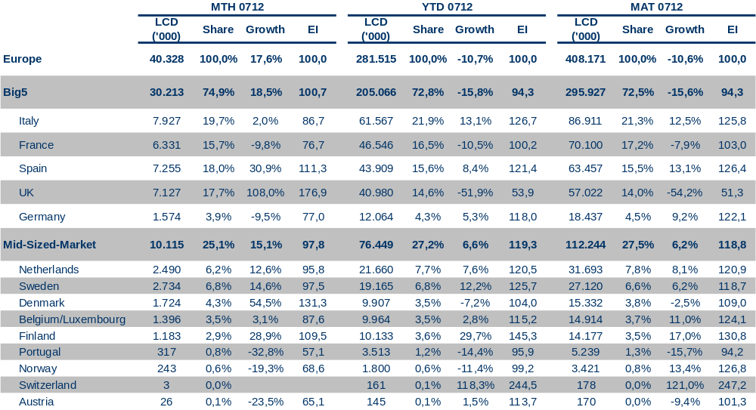
Haemophilia Franchise
Value Performance Overview
Share and EI is calculated vs. the Europe 16 Haemophilia market
Source: IMS MIDAS Data, MAT 07/2012

Slide 5
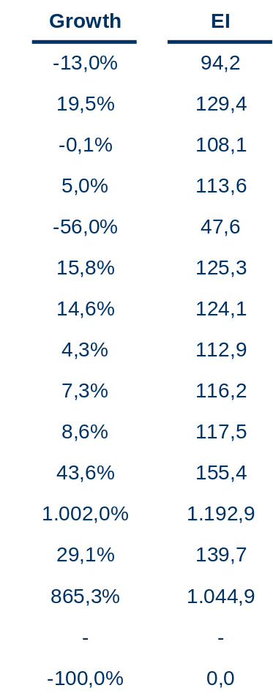
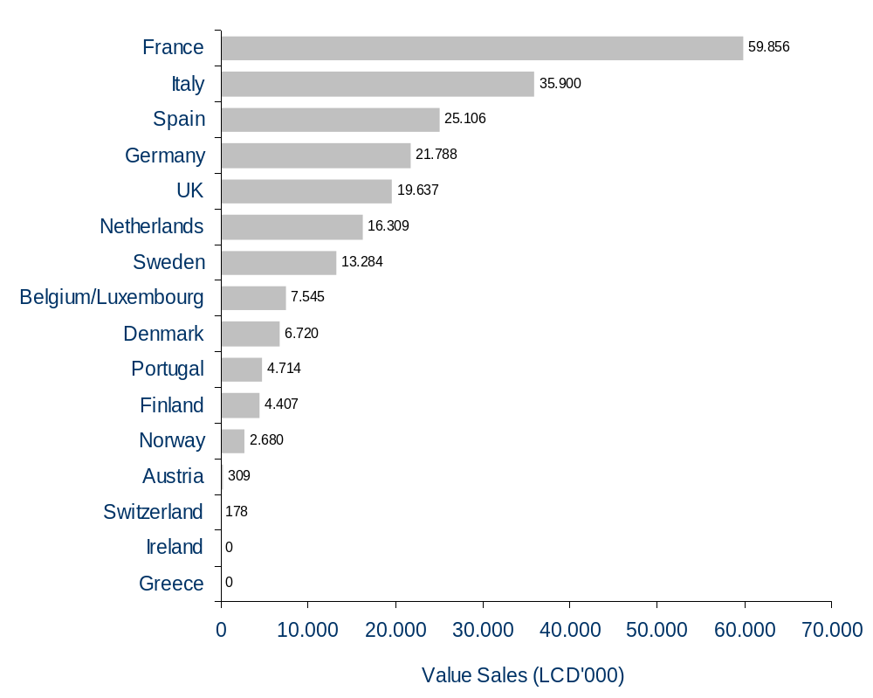
BeneFIX Market MAT Value Sales Performance
per Country
EI is calculated vs. the Europe 16 BeneFIX Market
Source: IMS MIDAS Data, MAT 07/2012

Slide 6
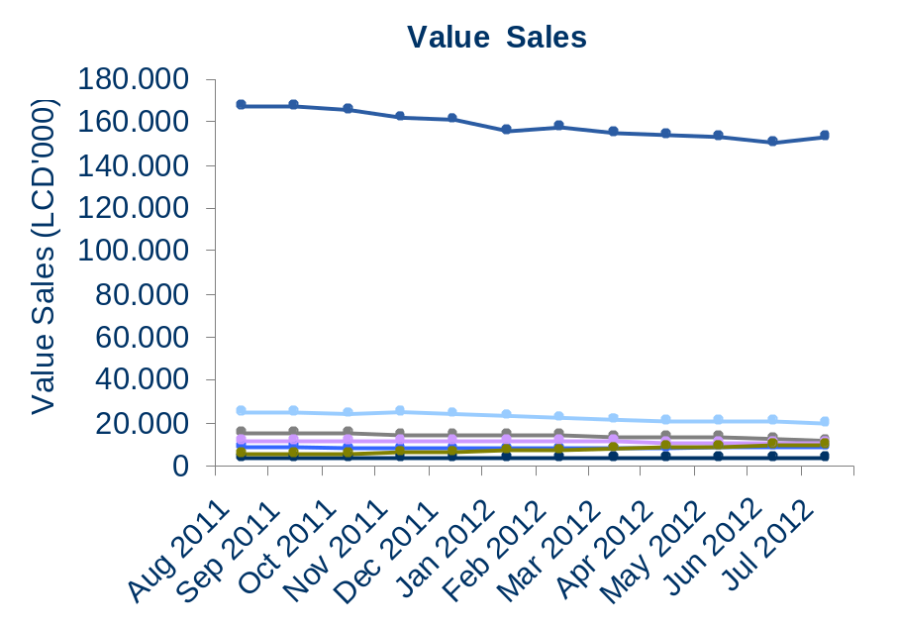
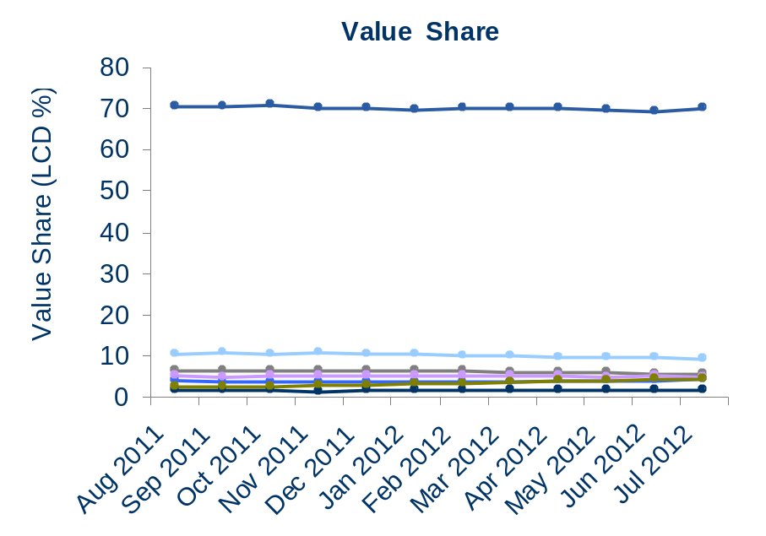
BeneFIX Market
MAT Value Trends
Share is calculated vs. the Europe 16 BeneFIX Market
Source: IMS MIDAS Data, MAT 07/2012

Slide 7
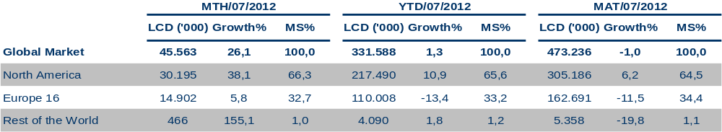
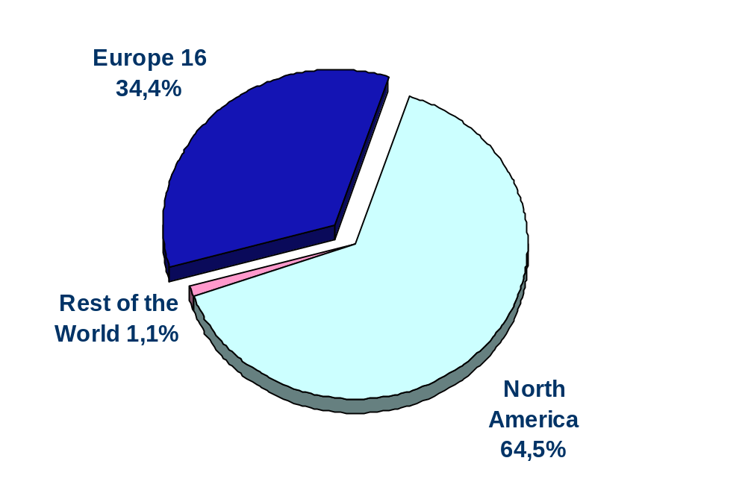
BeneFIX Value Sales Performance
per Region
MAT Sales share
Share is calculated vs. the Global BeneFIX market. Included are all BeneFIX sales in the country panels for North America (Canada, US, Puerto Rico) and for Rest of the World (Australia, Bulgaria, Croatia, Czech Rep, Estonia. Hungary, Latvia, Lithuania, Poland, Romania, Russia, Slovenia, Turkey)
Source: IMS MIDAS Data, MAT 07/2012

Slide 8
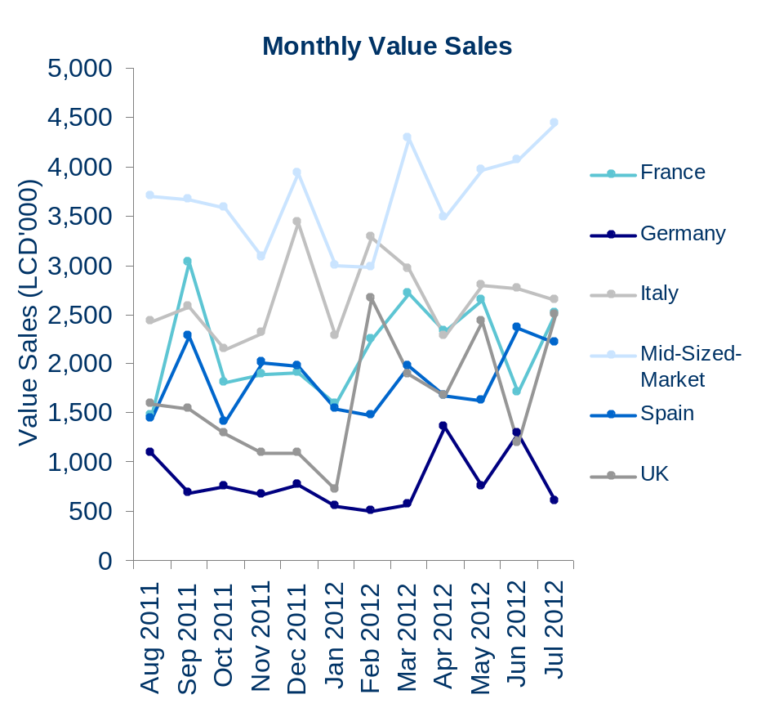
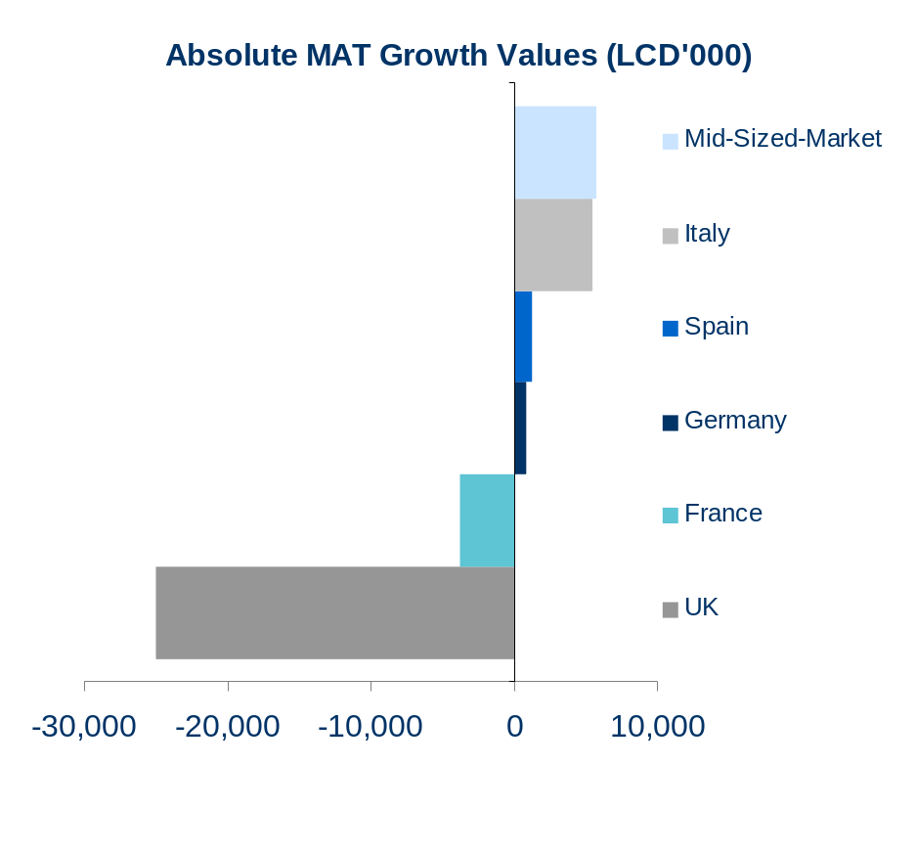
BeneFIX Sales Trends
by Country
Source: IMS MIDAS Data, MAT 07/2012

Slide 9
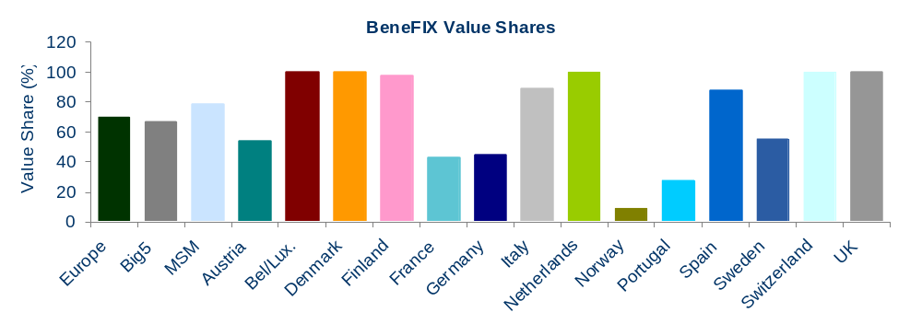
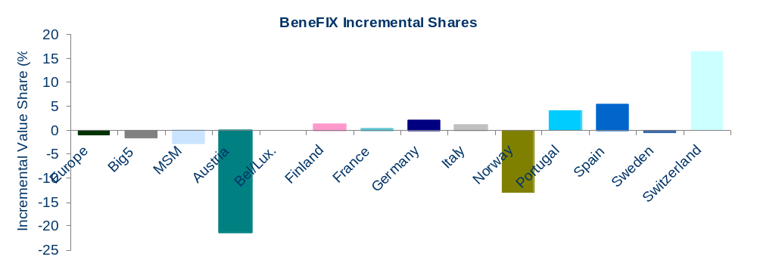
BeneFIX MAT Sales Shares
By Country
Share is calculated vs. the Country BeneFIX market
Source: IMS MIDAS Data, MAT 07/2012

Slide 10

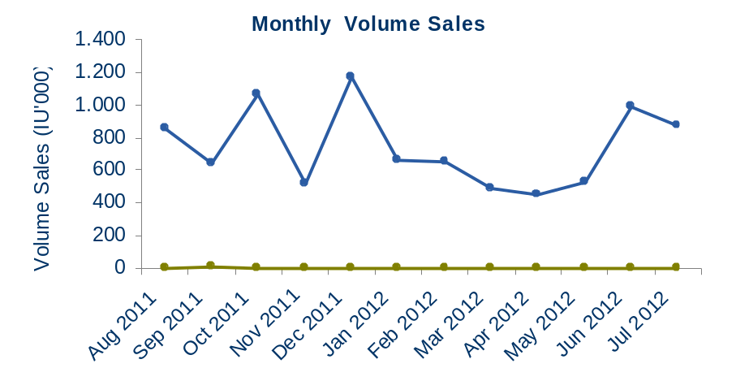
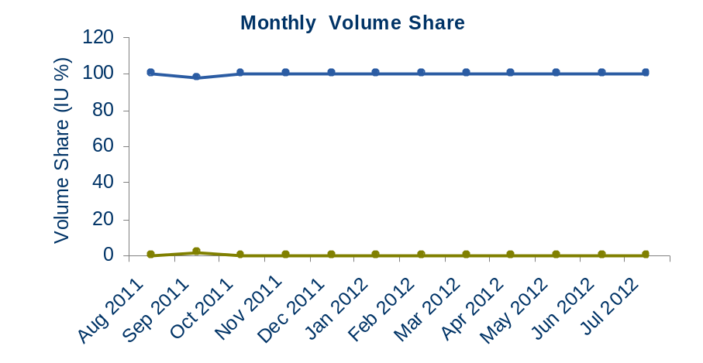
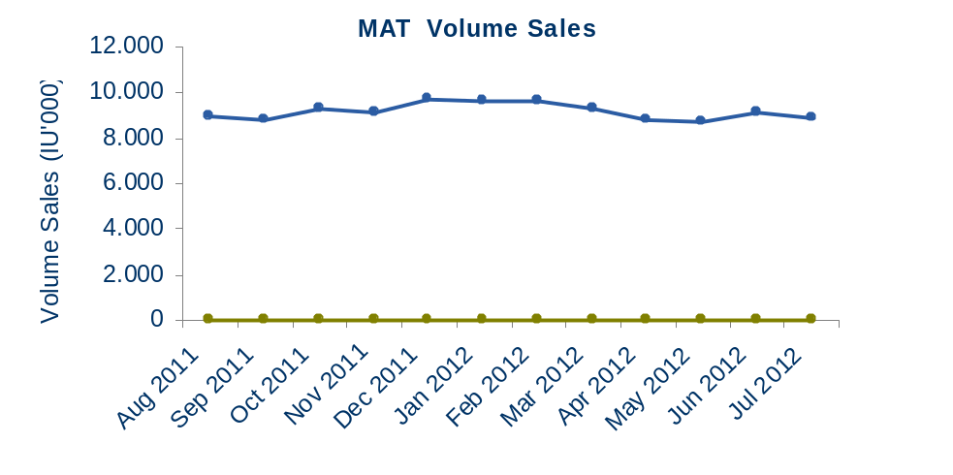
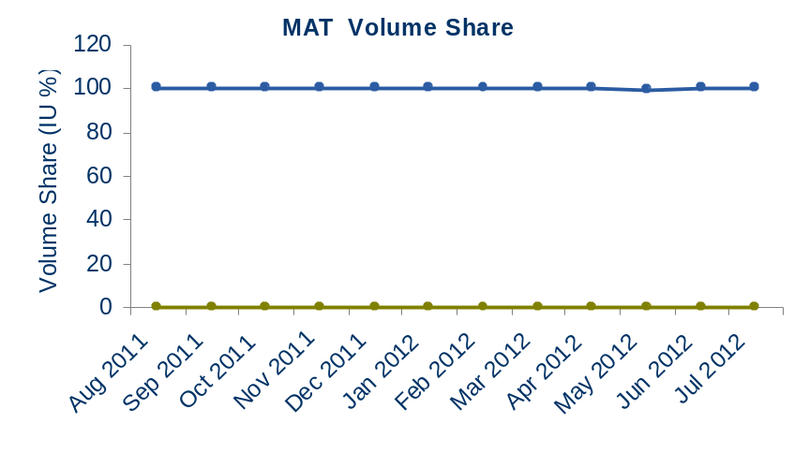
Belgium/Luxemb. BeneFIX Market Overview
Shares are calculated vs. the Country BeneFIX Market
Source: IMS MIDAS Data, MAT 07/2012

